Slide 1
Twilight Zone Crossover Assignment
Using TV’s past to teach archival research, character development, & socially conscious storytelling.

Slide 2
Learning Outcomes
Demonstrate knowledge of the various research processes used in story creation
Demonstrate knowledge regarding social justice media creation and its role in today’s society
Demonstrate knowledge of television series directing style, cinematic style, and narrative voice
Understanding of character development and it’s importance to series television

Slide 3
Crossover Assignment
Each production group will create a short 5-10 minute episode
Using a secondary or background character from an original Twilight Zone episode the group will develop an overlapping story for that character
It is important that we understand how the character in our new story arrived at the moment in time featured in the original episode.
Rod Serling used science fiction to tell stories with social justice themes, this should remain evident in the new character’s story.
Your grade will be based on your storytelling ability, attention to character development, visual composition and sound design, but most importantly your ability to work in a collaborative group.

Slide 4
VIDEO

Slide 5
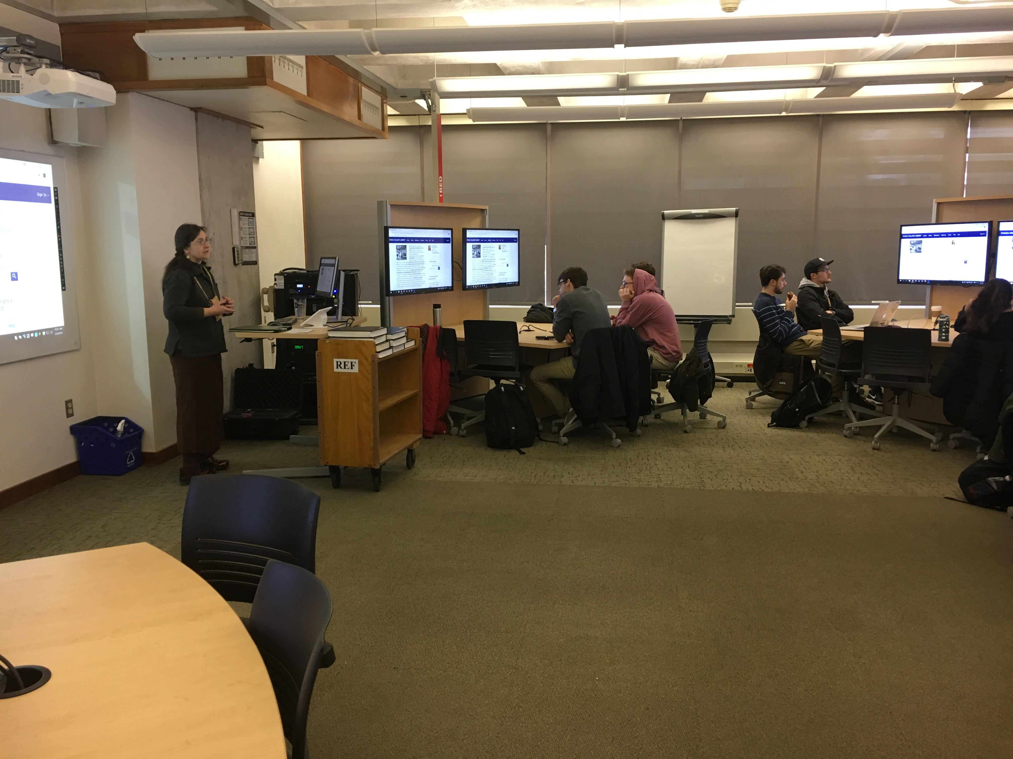
Library Collaboration
Holding class in the Library
Create a Library database
Examining Archival Materials
Rod Serling Archive at Ithaca College

Slide 6
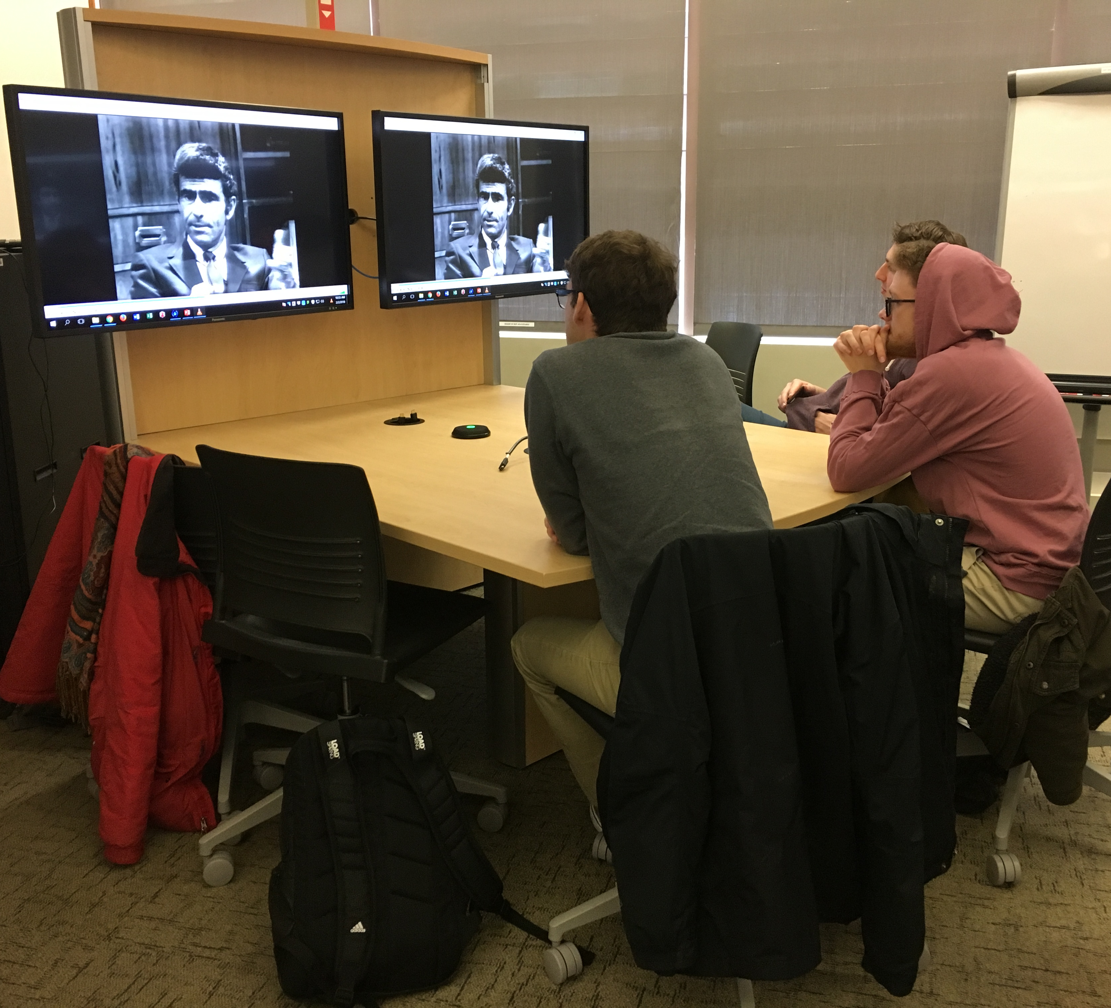
Archives
Television Academy Foundation: The Interviews
https://Interviews.televisionacademy.com
The Paley Center for Media
https://media.paleycenter.org/
The American Archive of Public Broadcast
http://americanarchive.org/
Museum of Broadcast Communications
http://www.museum.tv/eotv/eotv.htm

Slide 7
VIDEO

Slide 8
From Fiction Field Production to Academic Research Symposium

Slide 9
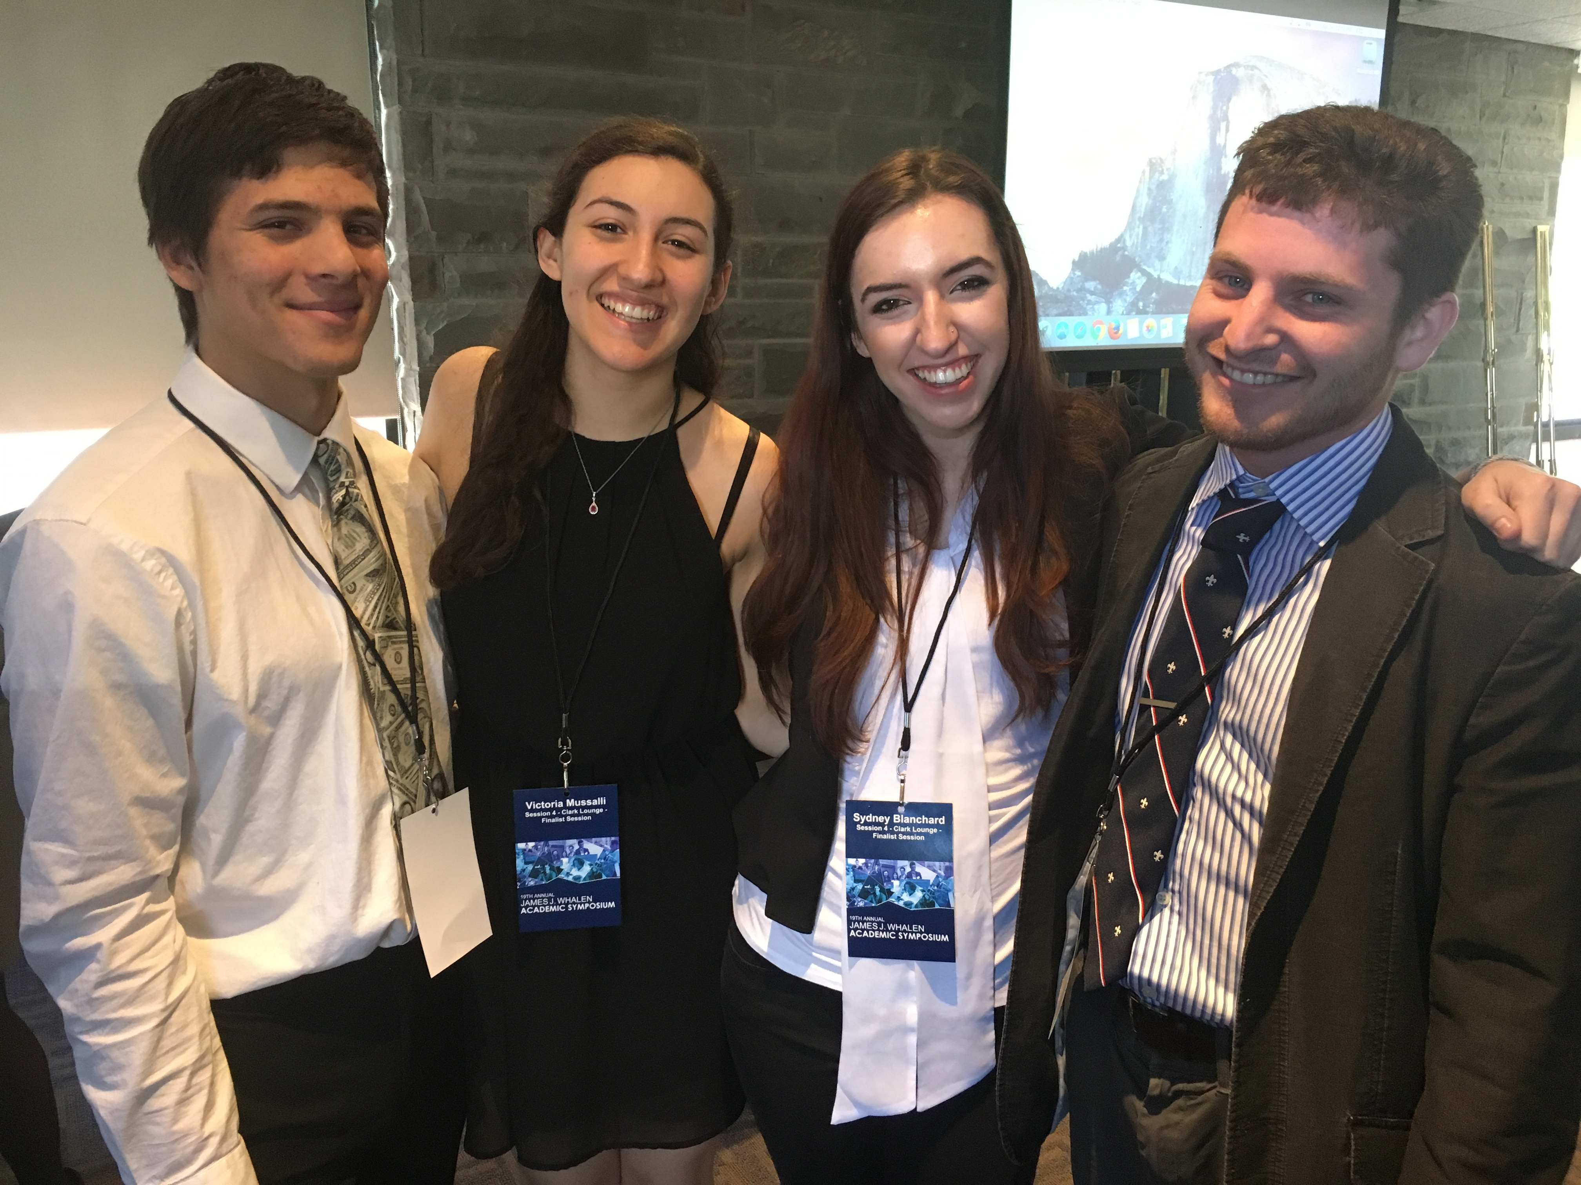
Thank you

