Slide 1
Building Best Friends
An Exercise in Animated Character Design
Notes:
Currently ¼ of our Games & Animation students are first generation
G&A majors are a majority of white, men and they tend in class to design characters that are familiar and like themselves
In this class they are learning basics of character design and animated storytelling. Required for all G&A majors and elective for several other majors

Slide 2
Challenges in Representation & Animation
Animated forms don’t rely on real-life so they can be grounded in reality or incredibly fantastical
You don’t have to rely on casting an actor to create the character. You build the character visually & narratively
Many opportunities to be creative but often students fall back to what’s familiar to them

Slide 3
Why Focus on Best Friends for the Exercise
Best friends are commonly used in animation, and most everyone has had one at some point
Close friendships can be complex relationships with commonalities, differences, disagreements, changes throughout time, etc.
Although a best friend could be a family member, they are likely to be someone outside of your family
Gives them a thematic constraint to work within
Notes:
EDIT 10 - point 8 work within constraints

Slide 4
Preparation - ahead of exercise
Ask students to prepare & turn in a short write up that considers their best friend (current or former)
Why are they your best friend?
What are your common experiences?
What are your different experiences?
What was something you fought over and how did you work it out?
What is your favorite activity together?
Was there a time you should have stood up for them and didn’t? One where you did?
Notes:
They don’t have to share this information with the whole class, but should turn in a short write up. They may want to use some of what they thought about when they do the main exercise.

Slide 5
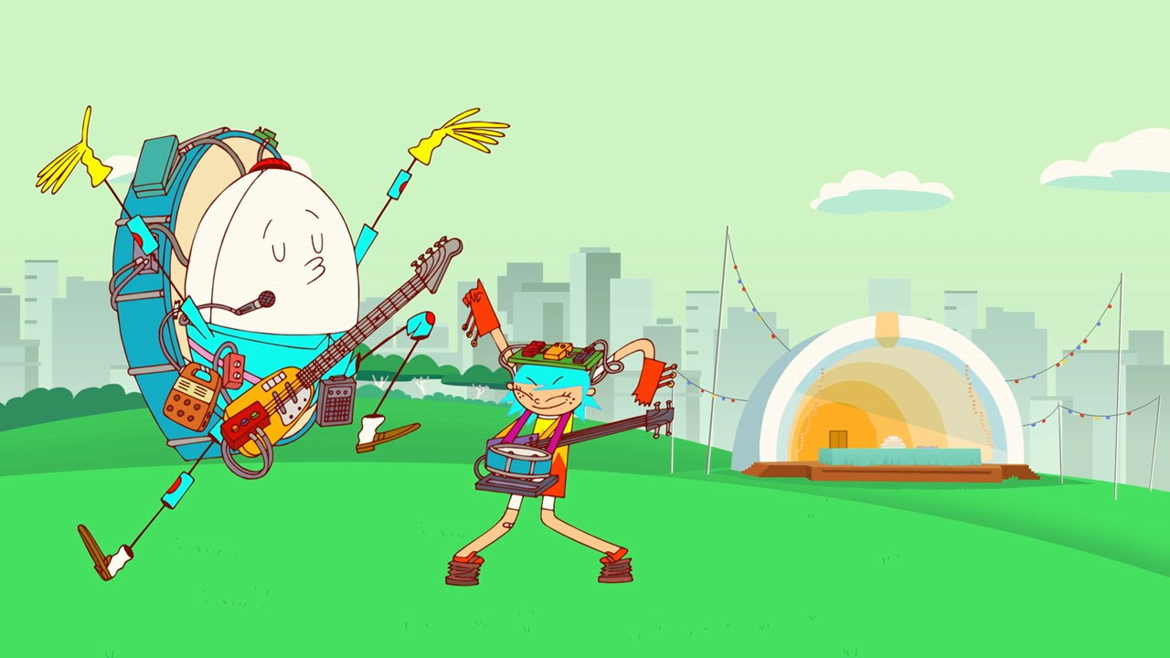
Analysis – ahead of exercise
Three examples of animated TV that focus on the relationship of best friends
Adventure Time (Jake & Finn), Danger & Eggs (DD & Phillip), and Craig of the Creek (Craig, Kelsey, JP)
Notes:
Fits in with Edit 10 – point 3 blend theory with practice – analysis beforehand to understand & apply ideas to character exercise

Slide 6
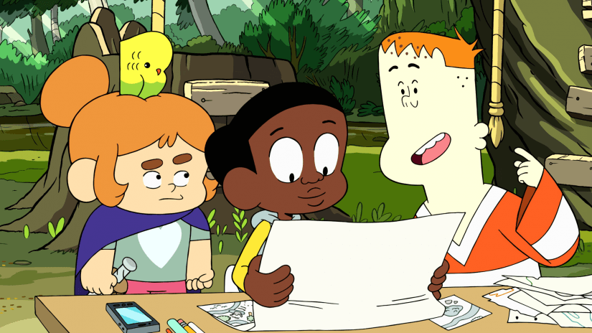
Analysis – ahead of exercise
Ask the students to analyze:
The characters’ visual designs
The characters’ personalities
How their personality comes through in the narrative & how it effects their design
The power dynamics in the friend group and with other characters. How does power play out in the narrative
Notes:
The point here is to getting them thinking about how character design & story work together - give them a foundation for understanding how characters, even ones developed for children’s TV can still be complex and emotionally authentic even in fantastical situations (Edit 5 – Character matters)
During analysis they may want to share if they saw aspects of their best friends in any of these characters, what aspects of their relationships reminded them of their own friendships, what was missing from what they saw and their own experience of having a best friend.
I’ve been trying to take an intersectional approach to character animation. Part of that is introducing them to how power dynamics exist within interpersonal relationship and how those dynamics can affect storytelling

Slide 7
Adventure Time – Finn & Jake
Reasons for including
Narrative focuses on Finn & Jake relationship
Animation can be fantastical, one character who is a human & one who is a magical dog
Takes a fairly common student idea (fight scene) and situates it within an emotional arc (Finn getting past a breakup)
Familiar, most of my students have seen at least some episodes
Dungeon Train episode, Nate Cash & Nick Jennings, 2013
Notes:
Target age group 9-14
Ease students into the analysis with something familiar.

Slide 8
Adventure Time – Finn & Jake
Finn
Jake
Character Design Elements
Human, white male, tall, top-heavy, round, cool but bright color palette, young teen
Personality Elements
Hero, brave, less self-aware than Jake, going through a period of doubt
Character Design Elements
Magical dog, male, yellow, short & round, but his body can morph, ages differently than a human around 30
Personality elements
Laid-back, jokes a lot, brave, mentor
Note – based on my students’ observations
Notes:
Finn ages from 12-17 throughout the series and would be 13 or 14 in the episode

Slide 9
Adventure Time – Finn & Jake
Student comments
Jake is Finn’s ”hype-man” in the episode trying to cheer him up, but also Finn’s emotional touchstone
Finn’s post-break-up mentality makes him his own obstacle in the story.
Characters’ physical forms are fluid (especially Jake) and rubbery
Dungeon Train episode, Nate Cash & Nick Jennings, 2013

Slide 10
Danger & Eggs – DD & Phillip
Reasons for including
Narrative focuses on DD & Phillip dealing with the emotions of a friend moving away
Animation can be fantastical, humans & an egg
Broader representation
New to my students
The Trio episode, Sarah Seember Huskin, Mike Owens, Brian Sheesly, 2017
Notes:
Target age group 6-11
Transgender co-creator, agender voice actor for Milo, Milo uses they/them/their pronouns, female lead, throughout series uses LGBTQ+ voice actors and themes, season finale takes place at Gay Pride Parade

Slide 11
Danger & Eggs – DD & Phillip
DD
Phillip
Milo
Character Design Elements
Human, white female, lots of triangles, fiery yellow & red dress with blue hair, kid
Personality Elements
Spontaneous, daredevil, emotional reactive, spiky, energetic
Character Design Elements
Egg, male, round with long limbs, face shrinks & grows with emotion, kid
Personality elements
Nervous, analytical, careful, emotionally thoughtful, can crack
Not a main character but integral to this episode’s story
Character Design Elements
Human, black non-binary (uses they), gender neutral hair style, clothes, & name, kid
Personality elements
Well-adjusted, likes music
Note – based on my students’ observations
Notes:
DD’s hair blends with Phillips shirt, but their shapes contrast showing their connection & differences

Slide 12
Danger & Eggs – DD & Phillip
Student comments
Educational without being obvious
Character move towards self-awareness (ie at one point they are mean to Milo for leaving, but realize it and apologize)
DD & Phillip are opposites but equals who care for and accept each other
The Trio episode, Sarah Seember Huskin, Mike Owens, Brian Sheesly, 2017

Slide 13
Craig of the Creek – Craig, Kelsey, & JP
Reasons for including
Narrative focuses the three friends exploring the creek together, this episode includes several characters but with the main three at the heart
Animation that is more grounded in reality
Broader representation
New show which few of my students have seen
Under the Overpass episode, Dashawn Mahone and Najja Porter, 2018
Notes:
First season still in progress as of summer 2018. Target age group 9-11
I debated a lot on which episode to use. For a storyline more focused on just the three main characters and their relationship – episode 15 The Brood is almost a bottle episode, also includes brief scene with Craig’s grandfather. I love episode 4 The Final Book, which involves trying to find a library book and using a Hardy Boy’s type book ‘Smarty Boys’ to solve the missing book mystery.
Lead character is black, socio-economic themes

Slide 14
Craig of the Creek – Craig, Kelsey, & JP
Craig
Kelsey
JP
Character Design Elements
Human, black male, rounded head, lanky body, big eyes, kid
Personality Elements
The leader, smart, artistic, curious, adventurous
Character Design Elements
Human, white female, short, boxy, has a bird in her hair, wears a cape & toy sword, kid
Personality elements
Deep into fantasy, warrior woman, reads a lot
Character Design Elements
Human, white male, big blocky head, tiny ears, wears a sports jersy, kid
Personality elements
Goofy sense of humor, a little weird, but fun, not the smartest, not wealthy
Note – based on my students’ observations

Slide 15
Craig of the Creek – Craig, Kelsey, & JP
Student comments
More complex narrative
Like the normal world, but a little more exaggerated
Characters are not fluid, but fixed in shape & scale
Craig’s curiosity drives the story
Power dynamic between Craig who knows about honeysuckle, Kit who runs the creek trading post, JP who wants but normally can’t afford stuff at the trading post
Under the Overpass episode, Dashawn Mahone and Najja Porter, 2018

Slide 16
Character Exercise – Best Friends Info for the Instructor
This exercise is story & art based, but does not require any software/computer skills
Students should answer character design questions and do a sketch of the characters
Students must work in small groups (3-4 people)
This is an exercise to get them thinking in new ways
They should think through all their decisions and be intentional in these decisions
Part of the point is for students to consider how within the same framework they all come up with different ideas and completely different characters
In the follow up class, have students display their sketches and talk about their decision making process.
Notes:
We have a mix of very technology savvy students and students who are not at all. This is an opportunity for any of them to shine without relying on tech
Knowing the students, I would divide groups as much as possible to focus on their different skill sets. I might look for students who are stronger artists to work with students who are stronger storytellers
It’s important in this to document the process & for students to think through their decisions and understand why they made a certain decision. Ideally their answers should be grounded in story. The answer for why a student didn’t answer a question or decided a question didn’t apply to their character can be as interesting & revealing about the character as actually answering the question.

Slide 17
Character Exercise – Best Friends Info for the Student
Using the set of character design questions and the baseline character personality traits, design a set of best friends.
Character 2 is the primary focus for the first part of the exercise, but you may find it works best to answer questions for them both at the same time
Come to consensus in your group. If you don’t agree on something, discuss why you each feel a certain way. Take turns speaking and let each person finish what they want to say.
Assign a notetaker for your answers & the reason for their answers
Feel free to start drawing as you answer questions. For the next class bring in a sketch of the character and be ready to discuss what decisions you made & why
Notes:
EDIT 10 – point 4, concept before craft

Slide 18
Character Exercise – Best Friends
Narrative framework – Character 2 wants to free the adorable pets from the chain pet store.
Character 1 Description – smart & level-headed, but also adventurous. Can creatively think their way out of problems.
Character 2 Description – Always taking on a new cause. Very passionate about these causes, but not always good at applying logic to them. Heart is in the right place even if their head is not.
Notes:
EDIT 10 – point 8, constraints – instead of having students try to figure out the story and the whole character personality, I provide a framework for them to work within. They don’t have to flesh out the whole narrative but should consider how these characters would react to this situation. Open enough for them to have flexibility within the framework.
Gender neutral pronouns and no character names so they the student can decide those details themselves. Descriptions focus on personalities rather than on physical descriptions.
Students can simultaneously think about how to design the character and how the narrative may be effected by developing the character’s personality & backstory more.

